Slide 1
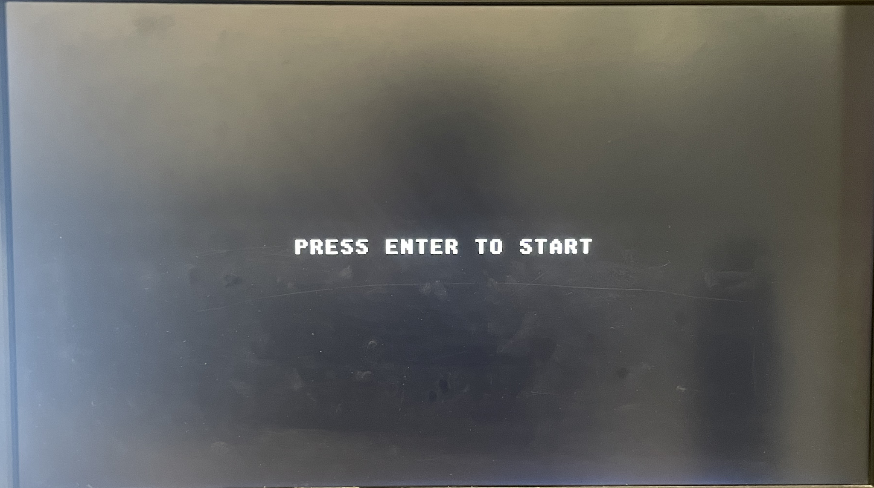
241 Project - Snake Game
Wenda Lou & Zhecheng Yin

Slide 2
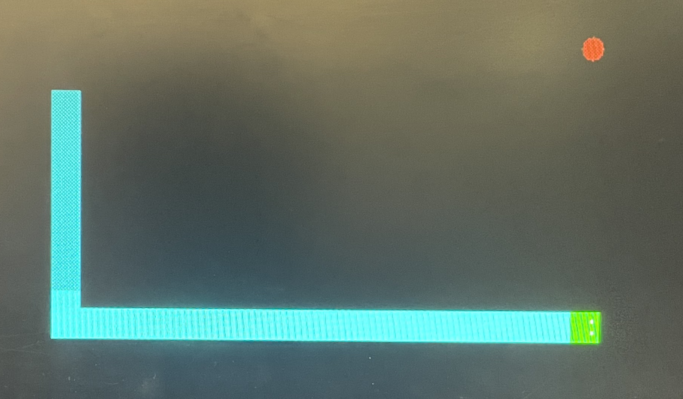
Snake Game
The game asks the user to control the direction of the snake to avoid hitting the wall or itself while eating “fruits” to get a score and grow bigger.
The inspiration comes from the 1978 game Blockade and the 1998 game Snake

Slide 3
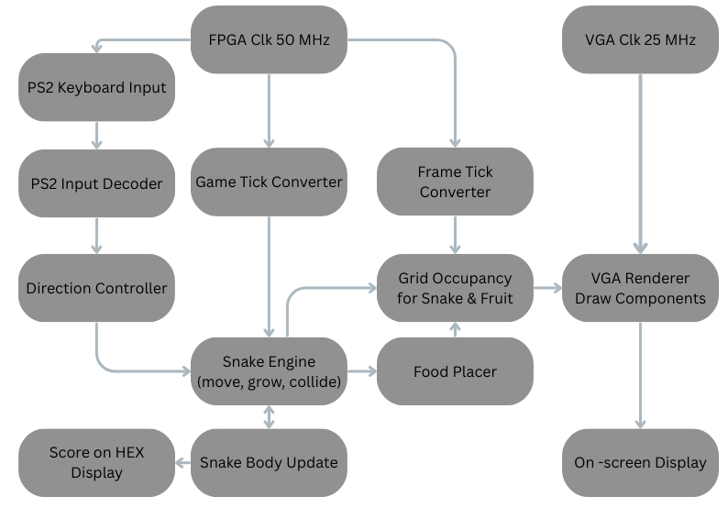
Snake Game - Overview

Slide 4
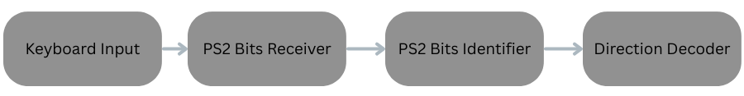
User Input - PS2
3 Verilog modules:
Receiving Module
Receive raw bits from keyboard
Identifying Module
Identify the keys pressed on keyboards (arrow keys, enter etc.)
Decoding Module
Decode key input to actual direction for main logic
Prevents illegal movements (go left from right)

Slide 5
Movement Logic
Use the direction command from user to guide the direction of snake
Set the initial position at the middle of the screen
40 * 30 grid from 640x480 screen
Change x-y position in the correct direction
Moving speed varies with scores – speed up for every 5 fruit eaten
Done by calling movement block at different frequency
8 game ticks per second
Move one grid every 4/2/1 ticks to control speed

Slide 6
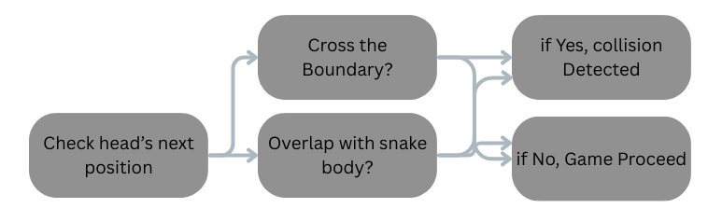
Collision Logic
The code detects 2 types of collision every time when doing movement:
Collision with the wall (boundary of screen)
Check the snake head position for next move – does it cross the boundary?
Collision with itself (snake body)
Snake body is stored in a list containing its position
Check the snake head’s next position through the vector for any overlapping

Slide 7
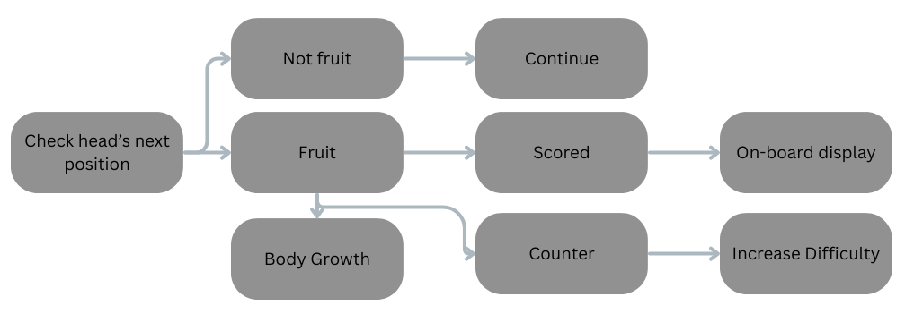
Score Logic
If the snake head’s next position is fruit:
The fruit will be “eaten”
If the fruit has been “eaten” 5 times, tell the code to speed up.
Score will increased by 1
The score will be shown on the HEX display on FPGA board in decimals

Slide 8
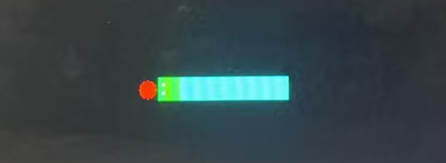
Snake Body Logic
Snake body is a list of position (grid) cells, with the head being the first element.
By default the snake has a length of 3 (1 head block and 2 body blocks)
Actions:
Movement:
Each body segments is overwritten by the position of its previous segment
i.e. body2 <= body1, body3 <= body2
Head is changed to the new position
Growth:
Length increased by 1 (new segment created at the end)
The last segment’s position will be assigned by the previous tail

Slide 9
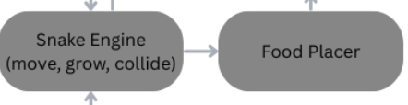
Fruit Logic
The fruit position logic is generated through a LFSR (Linear Feedback Shift register), basically it’s producing a pseudo-random coordinates with each movement
We calculate the Manhattan distance using these coordinate candidates, try to pick the furthest coordinates with snake’s head, and make sure it won’t generate on the boundary or snake body.
If all random candidates are not satisfied, we also make a fallback strategy to generate the fruit at the corner of the board.

Slide 10
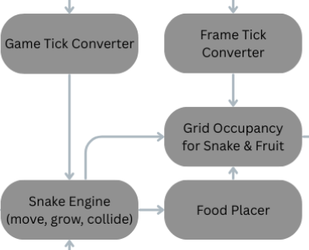
Snake Occupancy
Snake occupancy module responsible for maintaining a live map, which grid cell are occupied by the snake’s body
Instead of rebuilding the entire screen, it only updates the new head position and clearing the old tail during normal movement

Slide 11
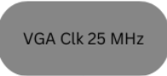
VGA CLK
The pixel clock for VGA display, controlling when each pixel drawn onto the screen at 25 MHz frequency.
Each clock cycle will draw 1 pixel onto the screen and this clock ensure to display (640*480) pixels in 1/60 second.

Slide 12
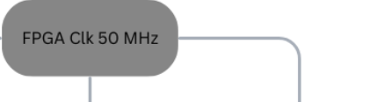
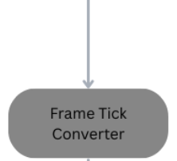
Frame Tick
Accept the Clock from FPGA (50 MHz) and create a slower frequency (30 Hz) for sending signal (frame tick)
This signal plays the same role as “FPS”, making sure that VGA won’t refresh in high frequency which may cause screen flicker seriously

Slide 13
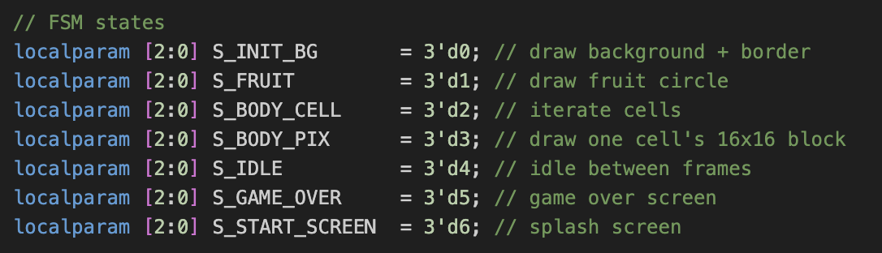
Painter - FSM

Slide 14
Painter - FSM -> S_START_SCREEN
Before the game begin, painter will generate the startup screen, simultaneously, it will displays the instructions to lead the player to start the game
At the middle of the screen, each pixel font is customized with (8*8). The text is achieved by reading the font’s bitmap and scaling it on VGA display

Slide 15
Painter - FSM -> S_INIT_BG
After pressing “Enter” on keyboard, state will walk into background initialization,
By utilizing FPGA’s clock, it will scan the entire display area pixel by pixel, drawing the black background, white boundary and get into the state of drawing fruit.

Slide 16
Painter - FSM -> S_FRUIT
When the background is initialized, FSM will receive the position of the fruit that given by system, and performs a partial scan (In previous state, FSM generate a local window for fruit)
Use the circle function, calculate the distance between pixel and fruit, and render the pixel into red if it belongs to the fruit

Slide 17
Painter - FSM -> S_BODY_CELL -> S_BODY_PIX
When the fruit is displayed, BODY_CELL state will go over the whole screen in unit of cell (16*16 px), check if the location is occupied or not (through a signal that calculated by snake engine)
If it’s occupied, it will get into BODY_PIX, which will traverse the cell (16*16 px) and sending color signal

Slide 18
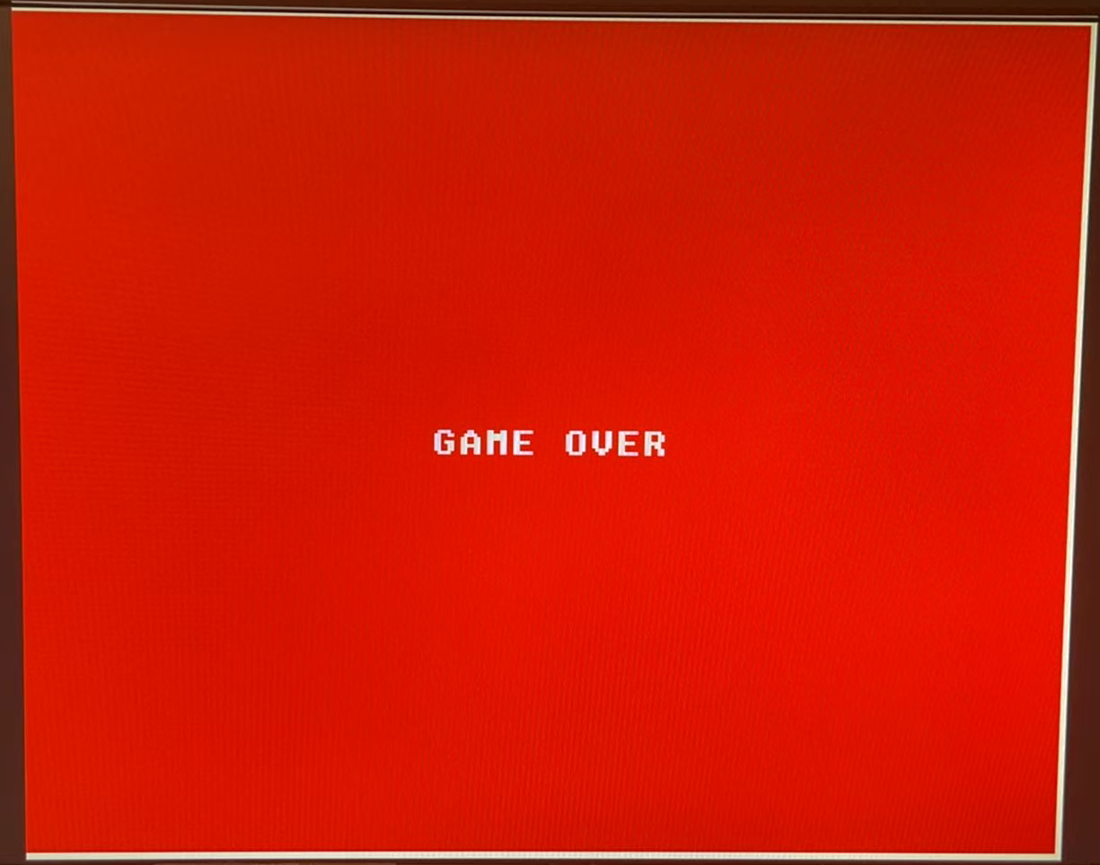
Painter - FSM -> S_GAME_OVER
Upon entering the game’s ending phase, painter will rescan the entire screen, filling the entire display with a red background while preserving the white borders
Simultaneously, it will render the text “GAME OVER” with the same logic as the START_SCREEN state

Slide 19
Painter - FSM -> S_IDLE
This state is the phase where the system waits for input, during this phase, the painter does not render anything.
It’s only detecting whether the game is begin or over, sending the FSM to the target state

Slide 20
Bugs during development
Wrong initial direction
The initial direction was going left but is designed to be right
Problem: the chip identify the initial state to be 00 (set to be left, right was set to be 01)
Fix: swap left and right (00 for right, 01 for left)
Wrong speed up logic (moves 2 grid at a time)
The previous logic is set tick to be 1 and times a coefficient to speed up
Problem: it goes 2/4 grids at a time → some of the position are never reached, and cause serious crash near boundary
Fix: instead of times coefficient, the game tick (now set to 8) is divided by a coefficient so that now the snake move 1 grid every 0.5/0.25 second other than 2 grids per second.

Slide 21
Future Work
Add a second snake and a mode-selection key to support both single-player and two-player gameplay.
Update the boundary collision so the white border becomes an actual obstacle instead of decoration.
Improve smoothness by switching the snake’s movement from cell-based steps to pixel-level motion.

Slide 22
Work Distribution
Wenda’s Part
Zhecheng’s Part

